Slide 1
22MAT230 Mathematics for Computing 4
Adaptive Toeplitz Convolution for ECG Signal Analysis
Team 17
CH. Priya Madhav - CB.SC.U4AIE24211
G.G. Rishi Kanth - CB.SC.U4AIE24218

Slide 2
INTRODUCTION
Convolution is a fundamental operation in signal processing used to analyze time-series data.
Traditionally, convolution is implemented using sliding window operations.
Convolution can also be represented using matrix operations through Toeplitz matrices.
Toeplitz matrices provide a structured way to represent shifted versions of a signal.
ECG signals can be analyzed using convolution to highlight abnormal heart patterns.

Slide 3
OBJECTIVES
To represent convolution using Toeplitz matrix formulation.
To design a fully adaptive convolution kernel whose size and values depend on signal statistics.
To apply adaptive Toeplitz convolution on ECG signals.
To classify ECG signals into normal and abnormal categories.
To evaluate performance using accuracy, confusion matrix, and ROC curve.

Slide 4
METHODOLOGY
Load the “ECG5000” dataset and normalize the ECG signals for stable processing.
Compute signal statistics such as mean (μ) and standard deviation (σ).
Construct an adaptive kernel based on these signal statistics.
Convert ECG signals into Toeplitz matrices and perform convolution using matrix multiplication.
Extract statistical features and classify ECG signals using a KNN classifier, evaluating performance using accuracy, confusion matrix, and ROC curve.

Slide 5
ADAPTIVE KERNEL
Kernel : Kernel size: k = 2 * [ασ + βlog(n)] + 1
Kernel values: K(i) = μ + (i − c)σ
The kernel is generated from the signal itself.
Kernel size changes depending on signal variability.
Mean represents the average signal value.
Standard deviation measures signal variation.
This makes the convolution adaptive to different signals.

Slide 6
TOEPLITZ MATRIX - INTRODUCTION
A Toeplitz matrix is a special type of matrix in which each diagonal from left to right has the same value.
It is a structured matrix commonly used in linear algebra and signal processing.
Toeplitz matrices are useful for representing systems where values depend on constant shifts or delays.
They appear in many applications such as signal processing, time-series analysis, and numerical computations.

Slide 7
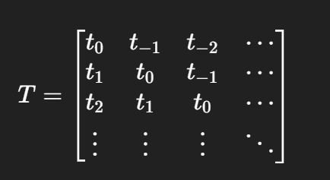
PROPERTIES OF TOEPLITZ MATRIX
Toeplitz Matrix Form :
In a Toeplitz matrix, all elements along each diagonal are constant.
A Toeplitz matrix is completely determined by its first row and first column.
The matrix structure represents shift-invariant relationships, which are common in signal processing.
Toeplitz matrices are widely used in numerical methods, time-series analysis, and linear systems because of their structured form.

Slide 8
CONVOLUTION - INTRODUCTION
Convolution is a mathematical operation used to combine two signals to produce a new signal.
It is widely used in signal processing and machine learning to analyze patterns in data.
In this project, convolution is applied to ECG signals using an adaptive kernel to highlight important signal variations.
The convolution operation helps enhance features in the signal, making abnormal patterns easier to detect.

Slide 9
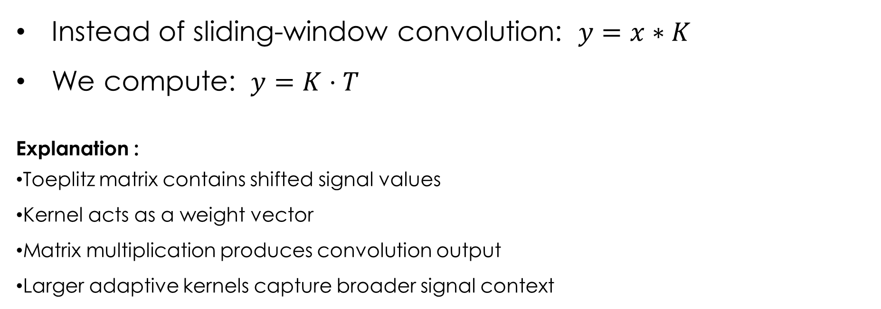
Convolution as Matrix Multiplication
Instead of sliding-window convolution: $y=x∗K$
We compute: $y=K⋅T$
Explanation :
Toeplitz matrix contains shifted signal values
Kernel acts as a weight vector
Matrix multiplication produces convolution output
Larger adaptive kernels capture broader signal context

Slide 10
LINEAR CONVOLUTION USING TOEPLITZ MATRIX
Linear convolution between a signal and a kernel can be represented using a Toeplitz matrix formulation.
The input signal is arranged into a Toeplitz matrix containing shifted versions of the signal.
The kernel is represented as a vector, and convolution is performed using matrix multiplication.
This approach provides a structured linear algebra representation of convolution, making it easier to analyze and implement computationally.

Slide 11
FEATURE EXTRACTION
After convolution, statistical features are extracted
Mean – average value of the signal
Standard deviation – variation in signal amplitude
Range – difference between maximum and minimum values
Energy variation – highlights sudden signal changes
These features numerically represent the signal characteristics.

Slide 12
CLASSIFICATION
K-Nearest Neighbors (KNN) classifier is used for classification.
Features extracted from ECG signals are used as inputs.
The classifier learns patterns from training data.
Signals are classified into normal or abnormal categories.
Performance is evaluated using: Accuracy , Confusion matrix and ROC curve

Slide 13
HEATMAP
The dataset contains 5000 ECG signals, so plotting all signals as lines becomes cluttered and hard to read.
A heatmap represents each signal as a row and each sample as a column, making large datasets easier to visualize.
Colours represent signal amplitude, helping us quickly identify patterns and variations.
It allows us to observe common patterns and abnormal regions across many ECG signals at once.

Slide 14
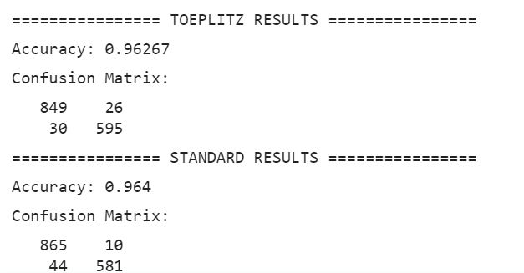
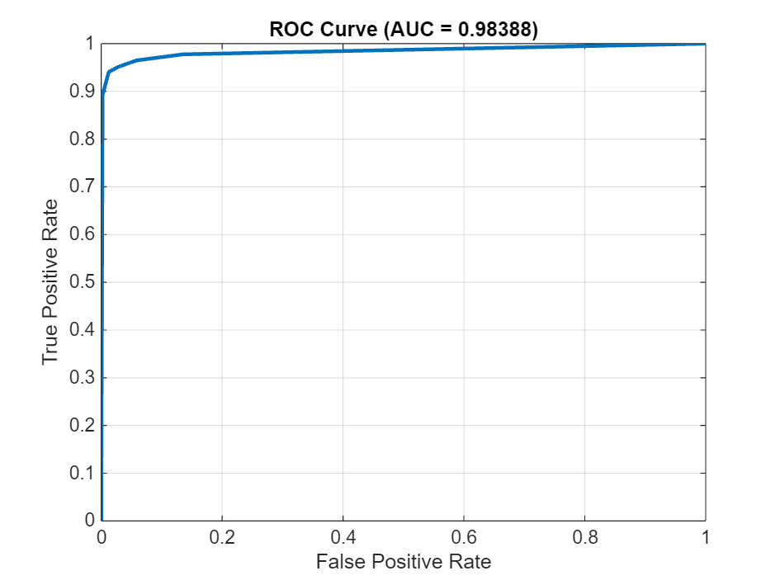
RESULTS

Slide 15
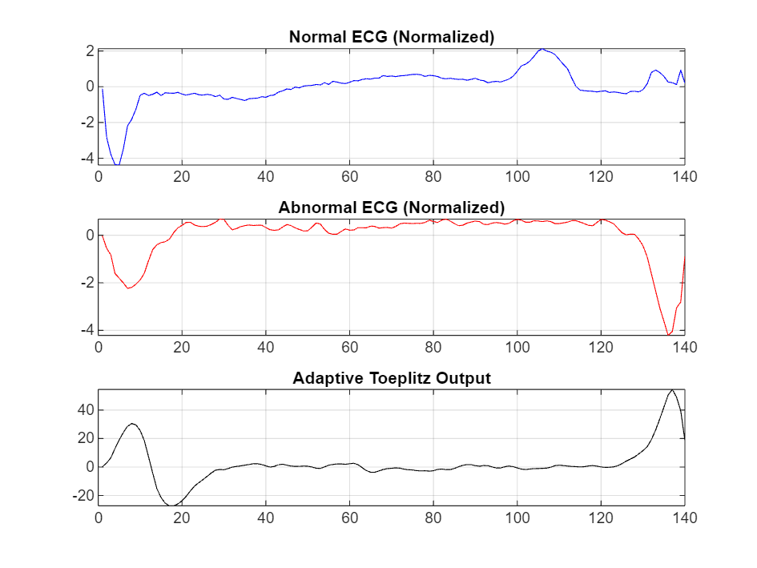
1 Signal Example:

Slide 16
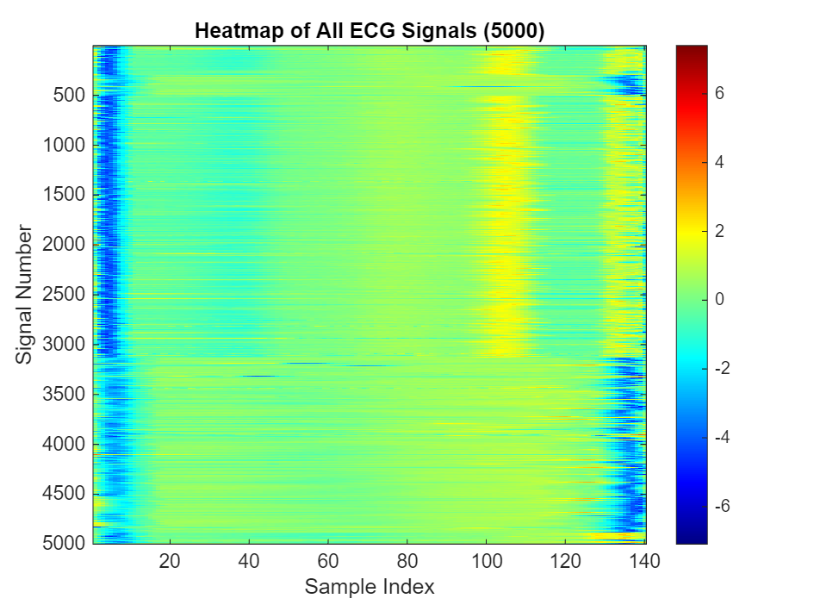
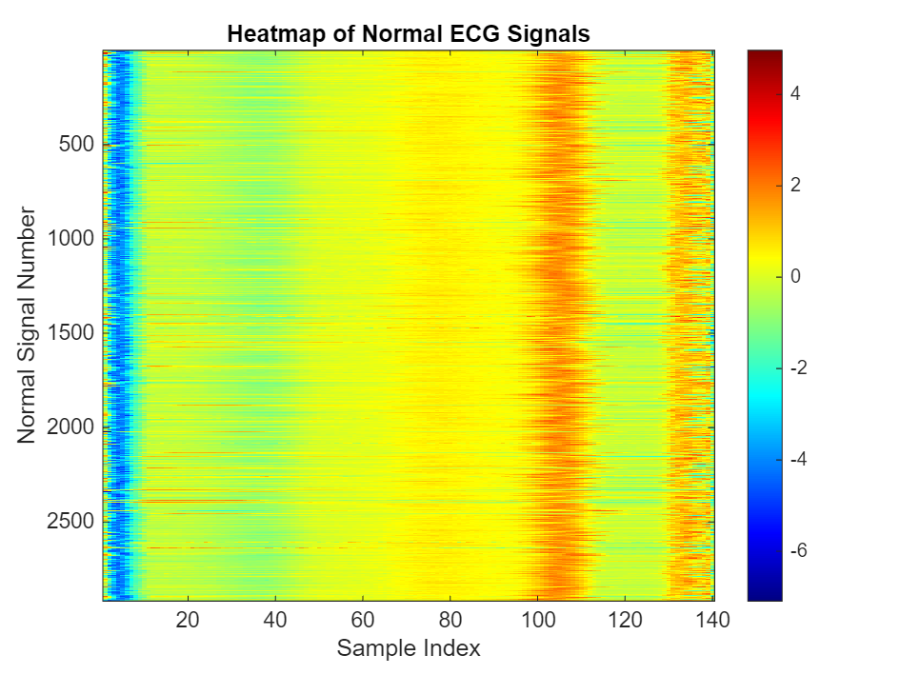

Slide 17
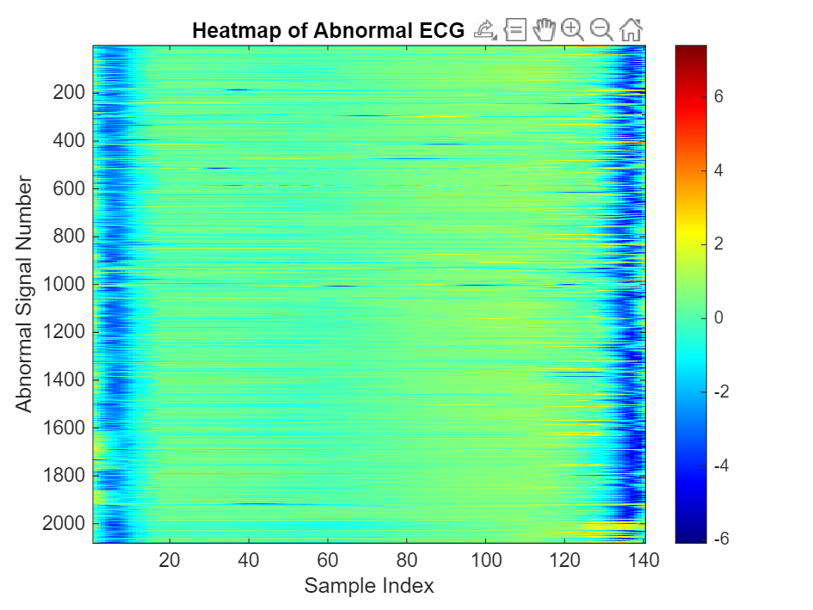

Slide 18
CONCLUSION
Adaptive Toeplitz convolution was implemented to analyse ECG signals using the “ECG5000” dataset.
The adaptive kernel adjusted its size and values based on signal statistics to enhance abnormal patterns.
Toeplitz matrix formulation enabled convolution through matrix multiplication.
Results showed strong performance with about 95% accuracy and an AUC of ~0.97, demonstrating effective detection of abnormal ECG signals.

Slide 19
THANK YOU

